Slide 1
ENERGY

Slide 2
ENDURING UNDERSTANDINGS
Energy can never be lost or created, but can change from one form to another
Energy is the ability to do work or cause change

Slide 3
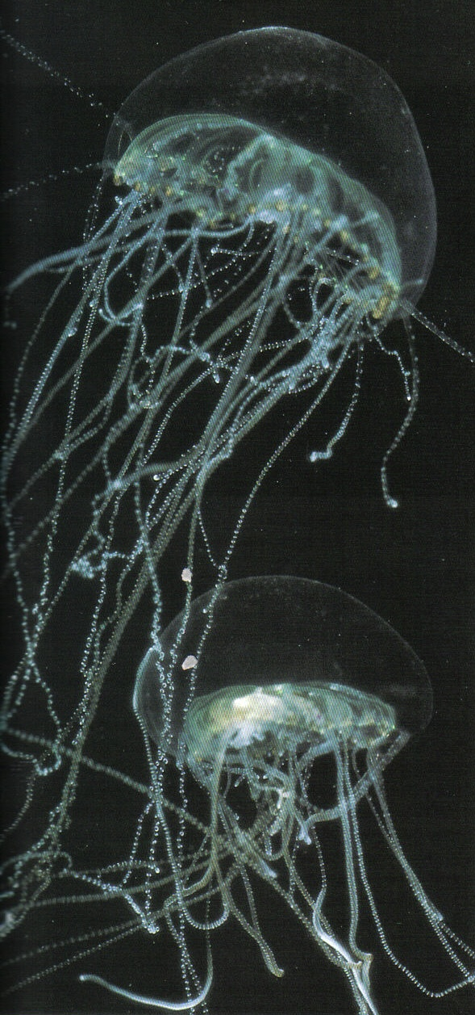
WORK
The transfer of energy is work
Work = force x distance
Energy can be transferred from one object to another or from one type of energy to another . . . such as chemical energy to electromagnetic energy

Slide 4
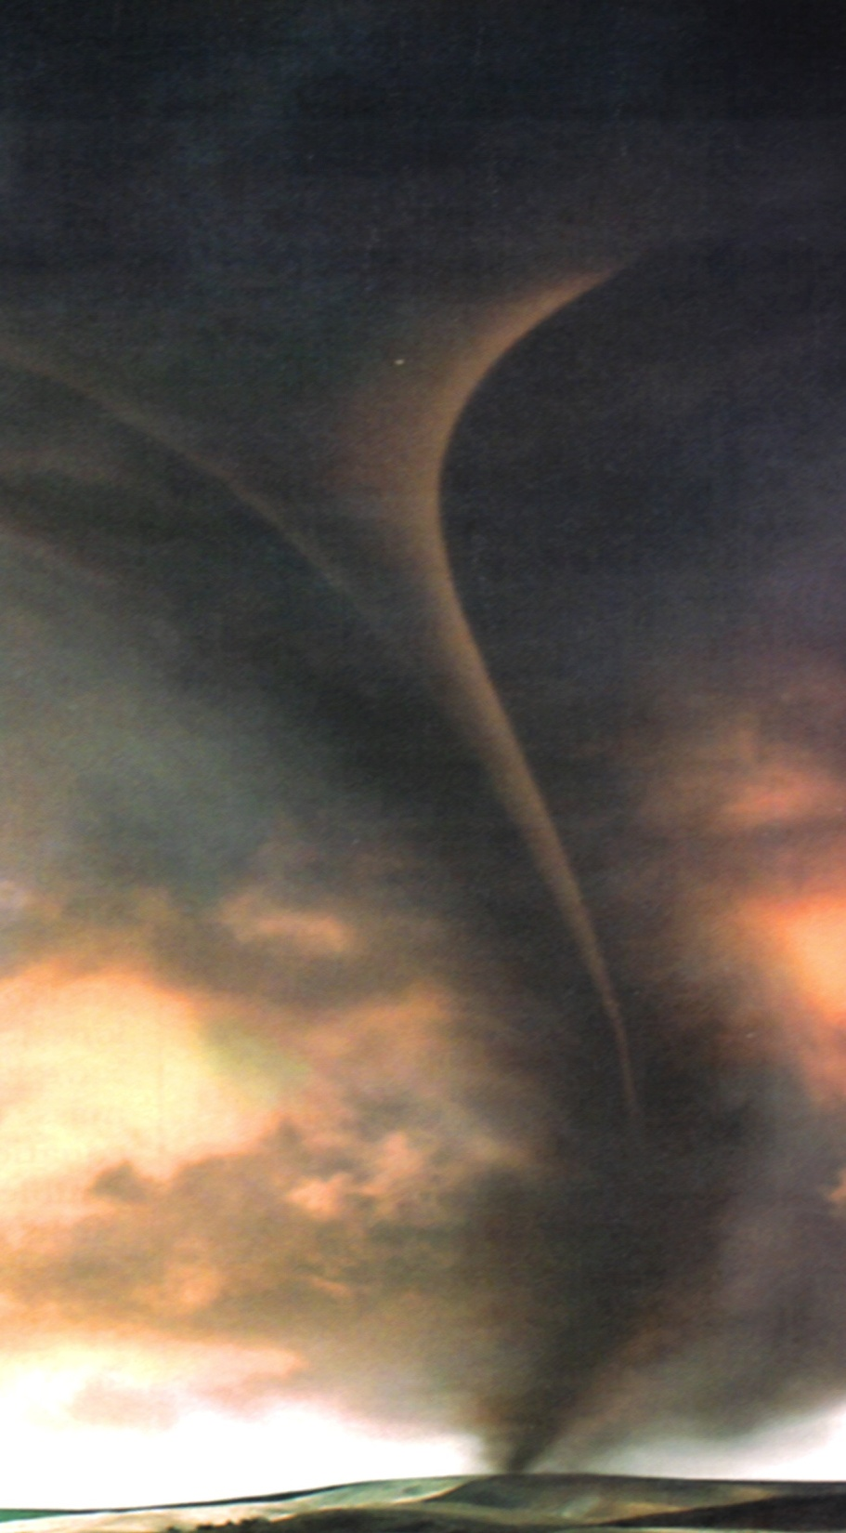
POWER
Power is the rate that energy is transferred
Power = energy transferred time
A tornado and a calm breeze each do the same amount of work if they transfer the same amount of energy, but a tornado does it in less time and therefore has greater power
Watts = Joules / seconds

Slide 5
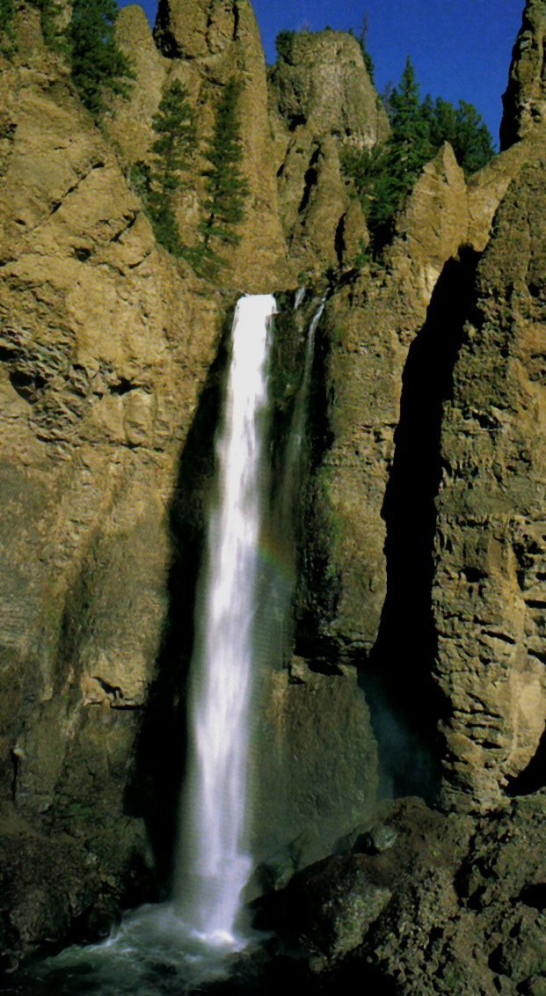
POTENTIAL ENERGY
Potential energy is energy stored due to position
Potential energy = weight x height
Joules = Newtons x meters
Gravitational potential energy equals the work done to lift an object, and depends on its weight and height
Elastic potential energy is related to objects that are stretched or compressed.
The farther an object stretches, the greater its elastic potential energy.

Slide 6
Try it . . .
What is the potential energy of a 100 kg rock that is sitting at the top of a hill 300 meters high?
E_{p} = mgh
E_{p} = 100 kg x 9.8 m/s² x 300 m
E_{p} = 294,000 J
A 4 kg flower pot is sitting on a window sill 30 meters above the sidewalk. What is its potential energy?
E_{p} = 4 kg x 9.8 m/s² x 30 m
E_{p} = 1,176 J

Slide 7
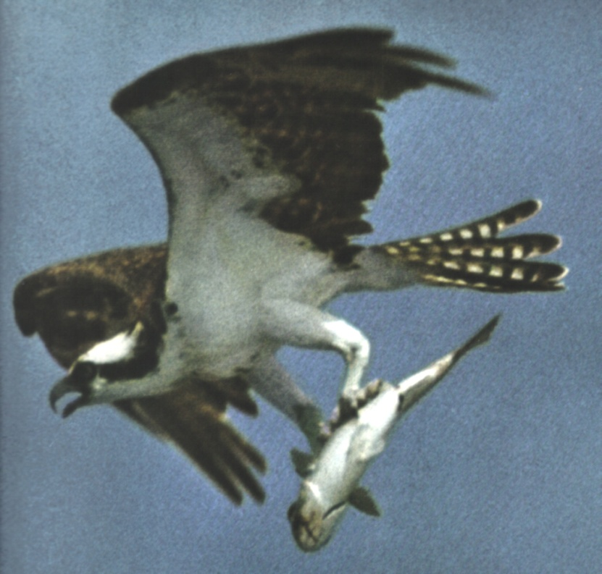
KINETIC ENERGY
Kinetic energy is the energy of motion
Kinetic energy depends on an object’s mass and velocity
Kinetic energy = ½ mass x velocity²
Joules = kg . m² / s²
Increasing velocity will have a greater effect on kinetic energy than increasing mass because velocity is squared

Slide 8
Try it . . .
What is the kinetic energy of a bicycle with a mass of 14 kg traveling at a velocity of 3 m/s?
E_{k} = ½ m x v²
E_{k} = ½ (14 kg) x (3 m/s)² => 7kg x 9 m²/s² => 63 kg*m²/s²
E_{k} = 63 J
A 1200 kg car is traveling at 100 m/s. How much kinetic energy does it possess?
E_{k} = ½ (1200 kg) x (100 m/s)²
E_{k} = 6,000,000 J

Slide 9
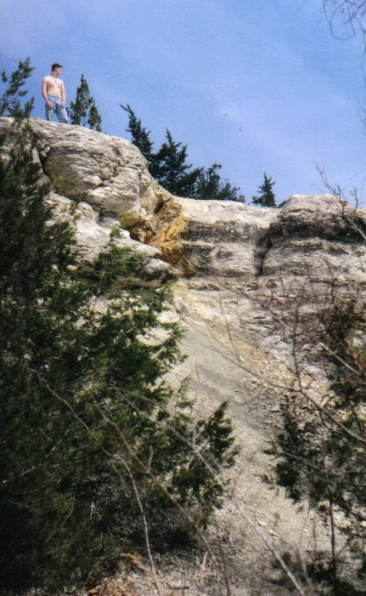
Try some more . . .
Is the climber exhibiting potential or kinetic energy in this picture?
potential
If his mass is 20 kg and the cliff is 10 meters high, how much energy does he have?
E_{p} = 20kg x 9.8 m/s² x 10m
E_{p} = 17,640 J
If the climber jumps and reaches the ground in 2 seconds, what was his kinetic energy?
E_{k} = ½ (20 kg) x (5m/s)²
E_{k} = 2,250 J

Slide 10
MECHANICAL ENERGY
Mechanical energy is energy associated with the position and motion of an object
Mechanical energy = potential energy + kinetic energy
An object with mechanical energy can do work on another object; in other words, mechanical energy is the ability to do work

Slide 11
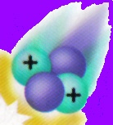
PARTICLE ENERGY
Energy associated with particles includes thermal, electrical, chemical, nuclear and electromagnetic energy
Because atoms and molecules are in constant motion they have kinetic energy, and their constant change in position gives them potential energy
Total kinetic and potential energy in the particles of an object is called thermal energy

Slide 12
TYPES OF ENERGY
Electrical energy is the energy of electrical charges, which can be moving (kinetic) or stored (potential)
Chemical energy is potential energy stored in the bonds that hold the atoms and molecules of chemical compounds together
Nuclear energy is potential energy stored in the nucleus of an atom that holds the protons together
Electromagnetic energy is energy that travels in waves, such as light, x-rays, heat, UV radiation and microwaves

Slide 13
ENERGY TRANSFORMATIONS
Most forms of energy can be transformed into other forms
Single transformations involve the changing of one form of energy into another, such as electrical into thermal or chemical into mechanical
Multiple transformations involve a series of changes, as in the lighting of a match… mechanical energy used to strike the match is transformed into thermal energy that releases stored chemical energy in the match, which is transformed into thermal and electromagnetic energy

Slide 14
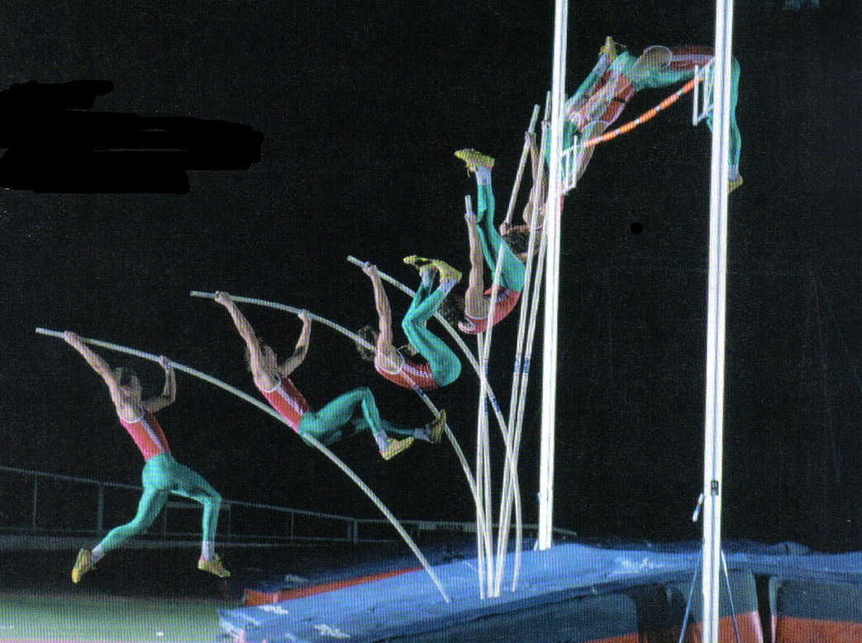
Describe the multiple transformations of a pole vaulter . . .
Running with the pole, the vaulter has kinetic energy.
As the pole bends the vaulter experiences elastic potential energy.
At the top of the jump, gravitational potential energy replaces elastic.
As the vaulter falls toward landing he experiences kinetic energy.

Slide 15
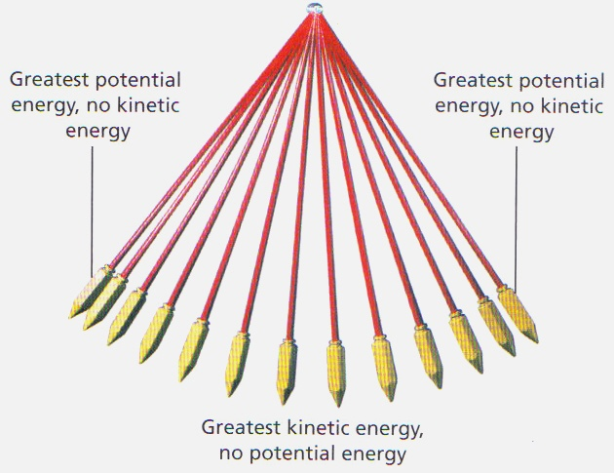
LAW OF CONSERVATION OF ENERGY
The law of conservation of energy states that as energy is transformed, no energy is lost
The transformation between kinetic and potential energy is one of the most common types of transformations

Slide 16
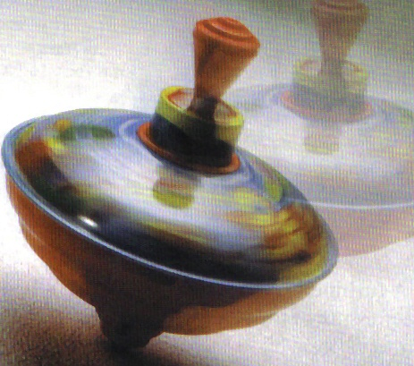
FRICTION
Friction often plays a major role in energy transformation
In nearly all energy transformations, friction transforms mechanical energy into thermal energy

Slide 17
E = MC²
Einstein’s famous equation describes the transformation of energy into matter
This equation somewhat altered the original definition to state that matter and energy are always conserved

Slide 18
Check yourself . . .
What is energy?
Describe the Law of Conservation of Energy
What is work?
How can energy be transformed?
What is power? What units measure power?
What is potential energy? What units measured potential energy?
What is the force of acceleration due to gravity?
What is gravitational potential energy?
What is elastic potential energy?
What is kinetic energy? On what does kinetic energy depend?
What is mechanical energy and what can mechanical energy do?
What 5 types of energy are related to particles? Describe each type.
Describe single and multiple energy transformations.
What does Einstein’s famous equation describe?

